Slide 1
Vectorization
By
Dr. S PADMANABHAN

Slide 2
Corpus
Collection of all available textual data is known as corpus.
Such collections may be formed of a single language of texts, or can span multiple languages.
Example:
“Bob ate Apples. Fred ate Apples. Bob and Fred ate pears.”

Slide 3
Tokenization
In Natural Language Processing (NLP), tokenization is the process of breaking down a stream of text into smaller units called tokens.
These tokens can be words, combination of words (n-grams), subwords, or even characters, depending on the level of granularity required.
Tokenization is a crucial step in many NLP tasks, including text processing, language modeling, and machine translation.

Slide 4
Tokenization
Applications
Text Preprocessing: Tokenization is the first step in preparing text data for further processing.
Language Modeling: Helps in building models that understand and generate human language.
Machine Translation: Essential for translating text from one language to another.

Slide 5
Example
Document #1
Document #2
He is a good boy. She is also good.
Radhika is a good person.
“He”, “is”, “a”, “good”, “boy”. “She”, “is” “also” “good”
“Radhika” “is” “a” “good” “person”.
Tokenization
Breaking text into tokens e.g words, chars etc

Slide 6
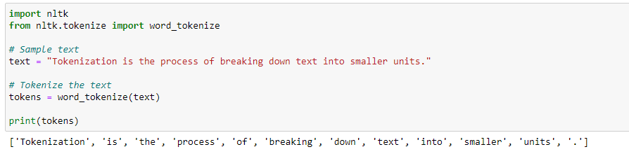
Python code - Example
Explanation
Importing Libraries: We import the necessary functions from the nltk library.
Sample Text: We define a sample text to tokenize.
Tokenization: We use the word_tokenize function to split the text into words.
Output: The tokens are printed, showing the individual words.

Slide 7
Vocabulary
Vocabulary is the set of distinct words that are used in a language. (Vocabulary of language)
Vocabulary refers to the distinct words in a selected corpus. (Vocabulary of corpus).
Any word in a document which is not found in the relevant vocabulary is considered Out of Vocabulary.

Slide 8
Example
Document #1
Document #2
He is a good boy. She is also good.
Radhika is a good person.
“He”, “is”, “a”, “good”, “boy”. “She”, “is” “also” “good”
“Radhika” “is” “a” “good” “person”.
Vocabulary
a, also, boy, good, He, is, person, She, Radhika
Build Vocabulary
Unique words in entire dataset

Slide 9
Document #1
Document #2
He is a good boy. She is also good.
Radhika is a good person.
Vocabulary
a, also, boy, good, He, is, person, She, Radhika
Vocabulary represents the ‘features’ of NLP data
Prepare vocabulary before building an NLP model

Slide 10
Text Data
“Hyderabad is the capital of Telangana.”
‘Hyderabad’, ‘is’, ‘the’, ‘capital’, ‘of’, ‘Telangana’, ’.’
Tokenization
Breaking text into tokens e.g words, chars etc

Slide 11
ML Model
Text Data as tokens
‘Hyderabad’, ‘is’, ‘the’, ‘capital’, ‘of’, ‘Telangana’, ’.’
Math works with numbers

Slide 12
ML Model
Text Data as tokens
‘Hyderabad’, ‘is’, ‘the’, ‘capital’, ‘of’, ‘Telangana’, ’.’
Convert Text to Numbers
Vectorization
Converting each token into number(s)

Slide 13
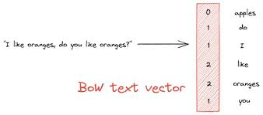
Vectorization
In the context of Natural Language Processing (NLP), vectorization refers to the process of converting text data into numerical vectors that can be used by machine learning algorithms.

Slide 14
Text to Numeric Conversion
Text to numeric conversion is an essential preprocessing step in Natural Language Processing (NLP), where text data is transformed into a numerical format that can be understood and processed by machine learning algorithms.
There are several techniques for converting text into numerical representations:

Slide 15

How to convert text into Numbers

Slide 16
Document #1
Document #2
He is a good boy. She is also good.
Radhika is a good person.
Vocabulary
a, also, boy, good, He, is, person, She, Radhika
Vocabulary | a | also | boy | good | He | Is | person | She | Radhika
Index | 0 | 1 | 2 | 3 | 4 | 5 | 6 | 7 | 8
Assign index for each word in vocabulary

Slide 17

How to convert individual documents into numbers using index and vocabulary?
We have multiple approaches …
Bag of words
CountVectorizer
TF-IDF Vectorizer

Slide 18

Bag of Words
A simple feature extraction approach in NLP
Ignores grammar / structure
Represents each document by measuring presence of vocabulary words
Words

Slide 19
Bag of Words (BoW)
This is one of the simplest techniques. The text is broken down into individual words (or n-grams), and a vocabulary of all unique words is created.
Each document or sentence is represented as a vector based on the Indication of ‘1’ if word was found, otherwise indicate ‘0’.

Slide 20
How it works
Tokenize text into words.
Build a vocabulary of all unique words.
Indicate ‘1’ if word was found, otherwise indicate ‘0’

Slide 21
Document #1
Document #2
He is a good boy. She is also good.
Radhika is a good person.
Vocabulary
a, also, boy, good, He, is, person, She, Radhika
Vocabulary | a | also | boy | good | He | is | person | She | Radhika
Index | 0 | 1 | 2 | 3 | 4 | 5 | 6 | 7 | 8
Document# 1
Check if each word in Vocabulary appears in Document #1

Slide 22
Document #1
Document #2
He is a good boy. She is also good.
Radhika is a good person.
Vocabulary
a, also, boy, good, He, is, person, She, Radhika
Vocabulary | a | also | boy | good | He | is | person | She | Radhika
Index | 0 | 1 | 2 | 3 | 4 | 5 | 6 | 7 | 8
Document #1 | 1 | 1 | 1 | 1 | 1 | 1 | 0 | 1 | 0
Indicate ‘1’ if word was found, otherwise indicate ‘0’

Slide 23
Document #1
Document #2
He is a good boy. She is also good.
Radhika is a good person.
Vocabulary
a, also, boy, good, He, is, person, She, Radhika
Vocabulary | a | also | boy | good | He | is | person | She | Radhika
Index | 0 | 1 | 2 | 3 | 4 | 5 | 6 | 7 | 8
Document #1 | 1 | 1 | 1 | 1 | 1 | 1 | 0 | 1 | 0
Document #2 | 1 | 0 | 0 | 1 | 0 | 0 | 1 | 0 | 1
Our data is now in table format and ready for ML model :)

Slide 24
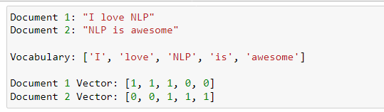
Example

Slide 25
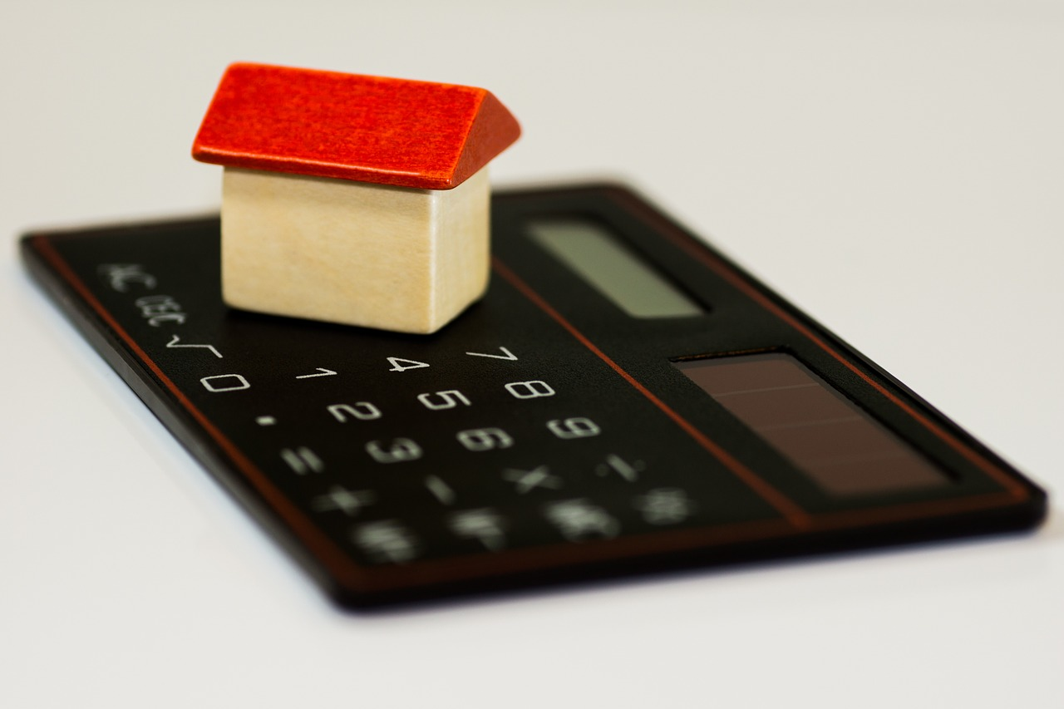
Count
Vectorizer

Slide 26
CountVectorizer
This is one of the simplest techniques. The text is broken down into individual words (or n-grams), and a vocabulary of all unique words is created.
Each document or sentence is represented as a vector based on the frequency of each word in that document.

Slide 27
How it works
Tokenize text into words.
Build a vocabulary of all unique words.
Each document or sentence is represented as a vector based on the frequency of each word in that document

Slide 28
Document #1
Document #2
He is a good boy. She is also good.
Radhika is a good person.
Vocabulary
a, also, boy, good, He, is, person, She, Radhika
Vocabulary | a | also | boy | good | He | is | person | She | Radhika
Index | 0 | 1 | 2 | 3 | 4 | 5 | 6 | 7 | 8
Document# 1
Count how many times each word in Vocabulary appears in Document #1

Slide 29
Document #1
Document #2
He is a good boy. She is also good.
Radhika is a good person.
Vocabulary
a, also, boy, good, He, is, person, She, Radhika
Vocabulary | a | also | boy | good | He | is | person | She | Radhika
Index | 0 | 1 | 2 | 3 | 4 | 5 | 6 | 7 | 8
Document #1 | 1 | 1 | 1 | 2 | 1 | 2 | 0 | 1 | 0
Document #1 = [1, 1, 1, 2, 1, 2, 0, 1, 0]

Slide 30
Document #1
Document #2
He is a good boy. She is also good.
Radhika is a good person.
Vocabulary
a, also, boy, good, He, is, person, She, Radhika
Vocabulary | a | also | boy | good | He | is | person | She | Radhika
Index | 0 | 1 | 2 | 3 | 4 | 5 | 6 | 7 | 8
Document #1 | 1 | 1 | 1 | 2 | 1 | 2 | 0 | 1 | 0
Document #2 | 1 | 0 | 0 | 1 | 0 | 1 | 1 | 0 | 1
Document #2 = [1, 0, 0, 1, 0, 1, 1, 0, 1]

Slide 31
Document #1
Document #2
He is a good boy. She is also good.
Radhika is a good person.
Vocabulary
a, also, boy, good, He, is, person, She, Radhika
 | a | also | boy | good | He | is | person | She | Radhika
Index | 0 | 1 | 2 | 3 | 4 | 5 | 6 | 7 | 8
Document #1 | 1 | 1 | 1 | 2 | 1 | 2 | 0 | 1 | 0
Document #2 | 1 | 0 | 0 | 1 | 0 | 1 | 1 | 0 | 1
Document Term Matrix (DTM)

Slide 32
CountVectorizer
The CountVectorizer from the scikit-learn library is a great tool for converting a collection of text documents into a matrix of token counts.

Slide 33
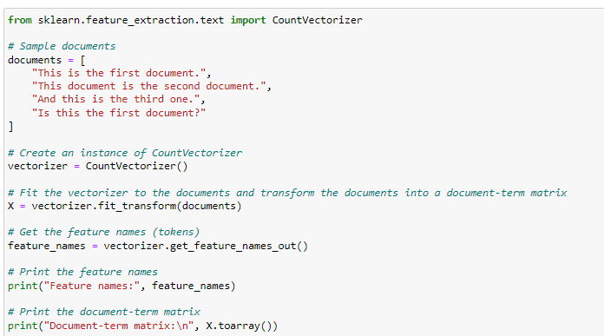
Example

Slide 34
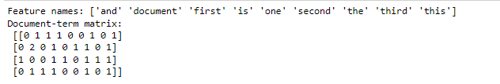
Output

Slide 35

TF-IDF Vector
Not just simple counting

Slide 36
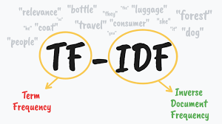

Slide 37
Term Frequency
measures how important a word is for a document
Inverse Document Frequency
How common (or uncommon) a word is across the dataset
TF-IDF
… involves two computations

Slide 38
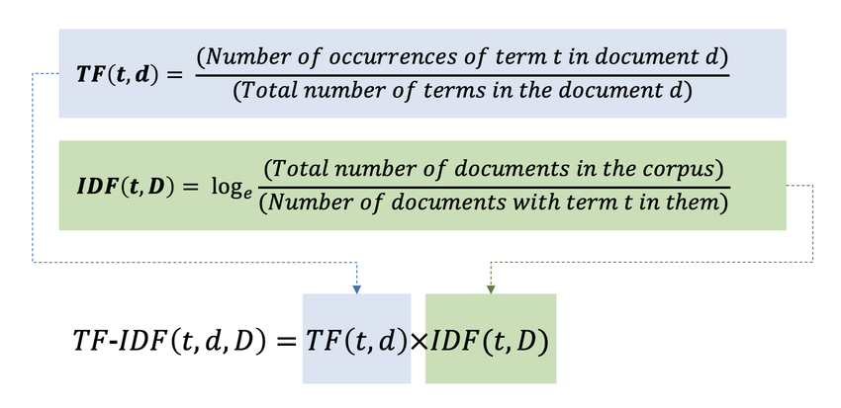

Slide 39

Document #1
He is a good boy. She is also good.
He | 1
is | 2
a | 1
good | 2
boy | 1
she | 1
also | 1
Total | 9
TF(He, doc#1) = 1/9 = 0.11
TF(good, doc#1) = 2/9 = 0.22
TF captures how important a word is to the document
(without looking at other documents in the dataset)

Slide 40
Document #2
Radhika is a good person.
Radhika | 1
is | 1
a | 1
good | 1
person | 1
Total | 5
TF(He, doc#2) = 0/5 = 0
TF(good, doc#2) = 1/5 = 0.2

Slide 41

Document #1
Document #2
He is a good boy. She is also good.
Radhika is a good person.
He | 1
is | 2
a | 1
good | 2
boy | 1
she | 1
also | 1
Total | 9
Radhika | 1
is | 1
a | 1
good | 1
person | 1
Total | 5
IDF(He) = log(2/1) = 0.301
IDF(good) = log(2/2) = 0
IDF tells us if a word (feature) can be used to distinguish documents.
If a word appears in majority of the documents then IDF will be close to ‘0’
i.e. give low weightage to that feature.

Slide 42
Document #1
Document #2
He is a good boy. She is also good.
Radhika is a good person.
He | 1
is | 2
a | 1
good | 2
boy | 1
she | 1
also | 1
Total | 9
Radhika | 1
is | 1
a | 1
good | 1
person | 1
Total | 5
IDF(He) = log(2/1) = 0.301
IDF(good) = log(2/2) = 0
TF-IDF(He, doc#1) = 0.11 * 0.301 = 0.03311
TF-IDF(good, doc#1) = 0.22 * 0 = 0
TF-IDF(He, doc#2) = 0 * 0.301 = 0
TF-IDF(good, doc#2) = 0.2 * 0 = 0

Slide 43
Document #1
Document #2
He is a good boy. She is also good.
Radhika is a good person.
Vocabulary
a, also, boy, good, He, is, person, She, Radhika
 | a | also | boy | good | He | Is | person | She | Radhika
Index | 0 | 1 | 2 | 3 | 4 | 5 | 6 | 7 | 8
Document #1 |  |  |  | 0 | 0.03311
Document #2 |  |  |  | 0 | 0
TF-IDF Vector

Slide 44
Purpose of Term Frequency (TF)
TF measures how frequently a term appears in a document.
It helps to understand the importance of a term within a specific document. The more frequently a term appears, the more important it is considered to be in that document.
TF normalizes the raw frequency of terms to account for the length of the document. This ensures that longer documents do not have an unfair advantage simply because they contain more words.
By measuring how often a term appears in a document, TF provides a straightforward way to gauge the significance of words within that document. When combined with IDF, it becomes a powerful tool for various NLP tasks.

Slide 45
Purpose of Inverse Document Frequency (IDF)
In any given corpus, some words (like “the”, “is”, “and”) appear very frequently across many documents. These common terms are not very informative for distinguishing between documents. By using the inverse document frequency, we reduce the weight of these common terms.
Terms that appear in fewer documents are often more informative and useful for identifying the content of a document. The inverse document frequency increases the weight of these less common terms, making them more significant in the TF-IDF score.

Slide 46
Interpreting TF-IDF Values
Low TF-IDF Value:
Meaning: The term is either very common across all documents or appears infrequently in the specific document.
Implication: The term is less important for distinguishing the document from others.
High TF-IDF Value:
Meaning: The term appears frequently in the specific document but not in many other documents.
Implication: The term is more important for distinguishing the document from others.

Slide 47
Summary
TF: Ranges from 0 to 1.
IDF: Typically greater than or equal to 0.
TF-IDF: Ranges from 0 to a positive value, often between 0 and 1 but can be higher.
This range ensures that common terms across documents are weighted less, while unique terms are given more importance, making the representation of documents more meaningful for various NLP tasks.

Slide 48
Reasons for TF-IDF = 0
A TF-IDF (Term Frequency-Inverse Document Frequency) score of 0 for a term in a document means that the term is not considered important for that document. Here are the specific reasons why this might happen:

Slide 49
Term Not Present in the Document:
Term Frequency (TF): If the term does not appear in the document at all, its term frequency (TF) will be 0.
Result: Since TF is 0, the TF-IDF score will also be 0, regardless of the IDF value.
Term Appears in All Documents:
Inverse Document Frequency (IDF): If the term appears in every document in the corpus, the IDF value will be 0.
Result: Even if the term appears frequently in the document (high TF), multiplying by an IDF of 0 will result in a TF-IDF score of 0.

Slide 50
Example Use Cases
Text Classification: High TF-IDF values can help identify key terms that are important for classifying documents into categories.
Information Retrieval: TF-IDF scores can rank documents based on the relevance of terms to a query, with higher scores indicating more relevant documents.
Text Summarization: Terms with high TF-IDF values can be used to generate summaries by highlighting the most important content.

Slide 51
TfidfVectorizer
Here’s how you can use the TfidfVectorizer from the scikit-learn library to create a TF-IDF (Term Frequency-Inverse Document Frequency) representation of our text data:

Slide 52
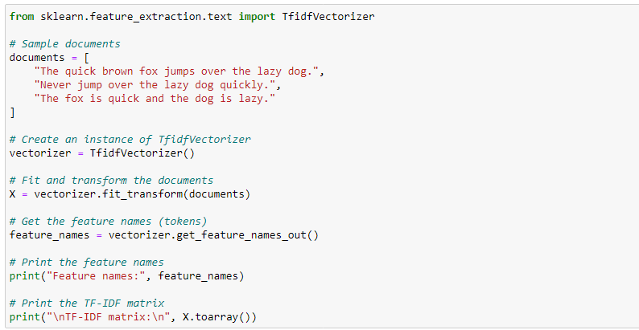
Example - Python code

Slide 53
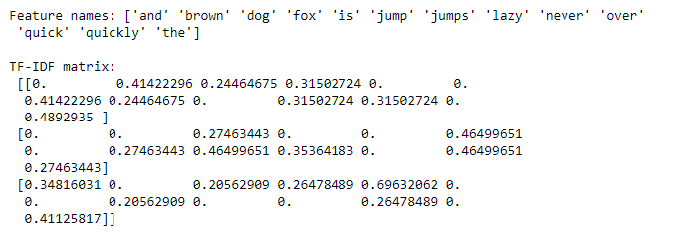
Output

